Slide 1

Database Systems: Design, Implementation, and Management Ninth Edition
Chapter 6
Normalization of Database Tables

Slide 2
Objectives
In this chapter, students will learn:
What normalization is and what role it plays in the database design process
About the normal forms 1NF, 2NF, 3NF, BCNF, and 4NF
How normal forms can be transformed from lower normal forms to higher normal forms
That normalization and ER modeling are used concurrently to produce a good database design
That some situations require denormalization to generate information efficiently
Database Systems, 9th Edition
‹#›

Slide 3
Database Tables and Normalization
Normalization
Process for evaluating and correcting table structures to minimize data redundancies
Reduces data anomalies
Series of stages called normal forms:
First normal form (1NF)
Second normal form (2NF)
Third normal form (3NF)
Database Systems, 9th Edition
‹#›

Slide 4
Database Tables and Normalization (cont’d.)
Normalization (continued)
2NF is better than 1NF; 3NF is better than 2NF
For most business database design purposes, 3NF is as high as needed in normalization
Highest level of normalization is not always most desirable
Denormalization produces a lower normal form
Increased performance but greater data redundancy
Database Systems, 9th Edition
‹#›

Slide 5
The Need for Normalization
Example: company that manages building projects
Charges its clients by billing hours spent on each contract
Hourly billing rate is dependent on employee’s position
Periodically, report is generated that contains information such as displayed in Table 6.1
Database Systems, 9th Edition
‹#›

Slide 6
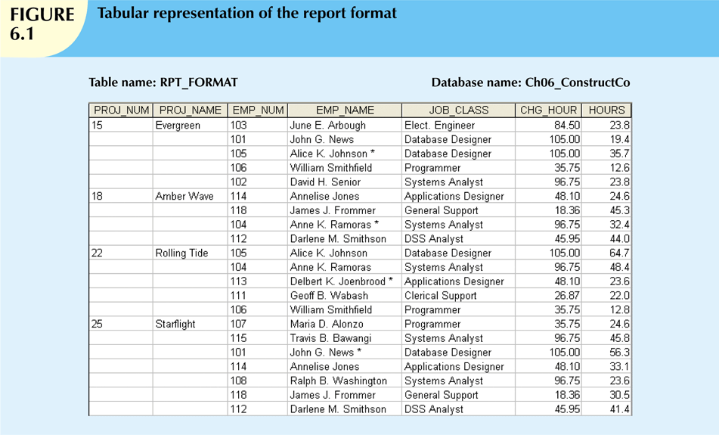
Database Systems, 9th Edition
‹#›

Slide 7
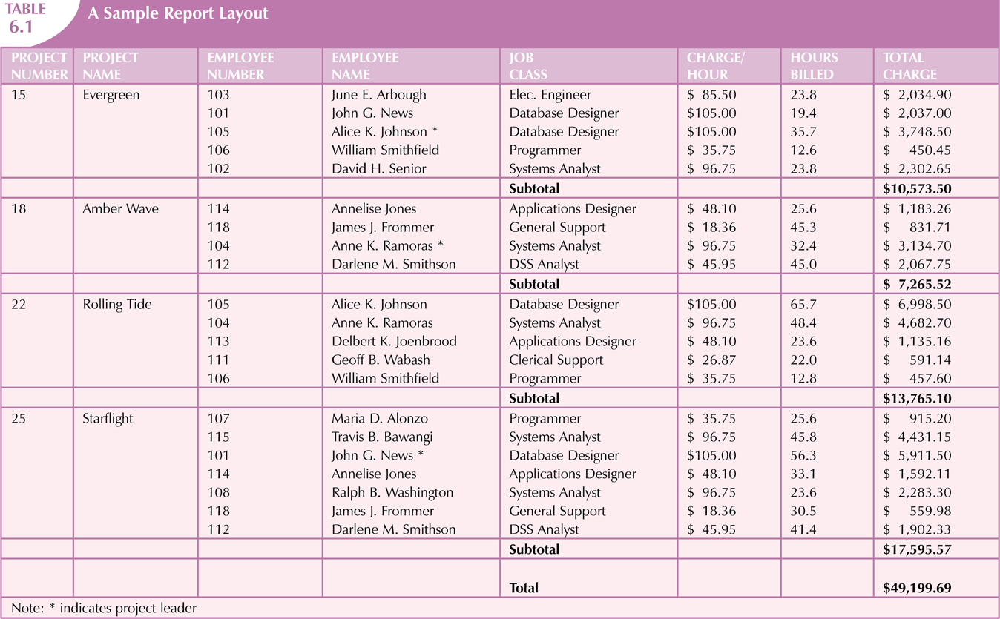
Database Systems, 9th Edition
‹#›

Slide 8
The Need for Normalization (cont’d.)
Structure of data set in Figure 6.1 does not handle data very well
Table structure appears to work; report is generated with ease
Report may yield different results depending on what data anomaly has occurred
Relational database environment is suited to help designer avoid data integrity problems
Database Systems, 9th Edition
‹#›

Slide 9
The Normalization Process
Each table represents a single subject
No data item will be unnecessarily stored in more than one table
All nonprime attributes in a table are dependent on the primary key
Each table is void of insertion, update, deletion anomalies
Database Systems, 9th Edition
‹#›

Slide 10
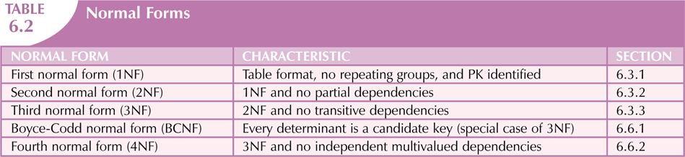
Database Systems, 9th Edition
‹#›

Slide 11
The Normalization Process (cont’d.)
Objective of normalization is to ensure that all tables are in at least 3NF
Higher forms are not likely to be encountered in business environment
Normalization works one relation at a time
Progressively breaks table into new set of relations based on identified dependencies
Database Systems, 9th Edition
‹#›

Slide 12
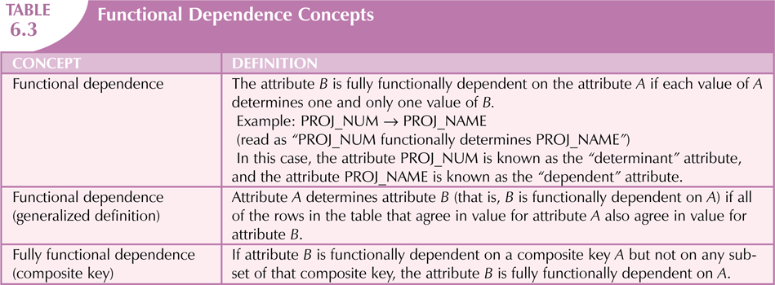
Database Systems, 9th Edition
‹#›

Slide 13
Conversion to First Normal Form
Repeating group
Group of multiple entries of same type can exist for any single key attribute occurrence
Relational table must not contain repeating groups
Normalizing table structure will reduce data redundancies
Normalization is three-step procedure
Database Systems, 9th Edition
‹#›

Slide 14
Conversion to First Normal Form (cont’d.)
Step 1: Eliminate the Repeating Groups
Eliminate nulls: each repeating group attribute contains an appropriate data value
Step 2: Identify the Primary Key
Must uniquely identify attribute value
New key must be composed
Step 3: Identify All Dependencies
Dependencies are depicted with a diagram
Database Systems, 9th Edition
‹#›

Slide 15
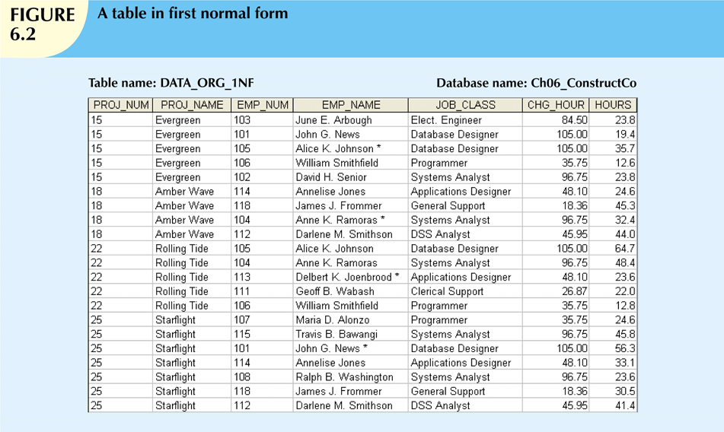
Database Systems, 9th Edition
‹#›

Slide 16
Conversion to First Normal Form (cont’d.)
Dependency diagram:
Depicts all dependencies found within given table structure
Helpful in getting bird’s-eye view of all relationships among table’s attributes
Makes it less likely that you will overlook an important dependency
Database Systems, 9th Edition
‹#›

Slide 17
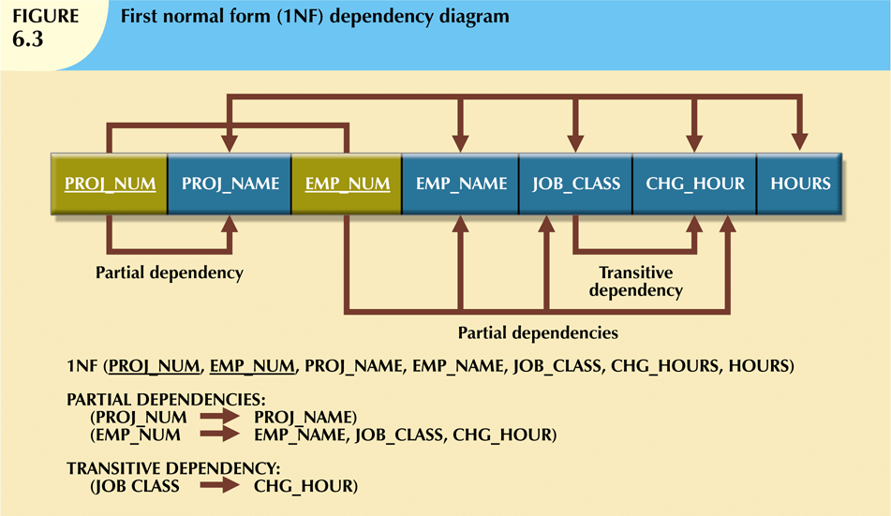
Database Systems, 9th Edition
‹#›

Slide 18
Conversion to First Normal Form (cont’d.)
First normal form describes tabular format:
All key attributes are defined
No repeating groups in the table
All attributes are dependent on primary key
All relational tables satisfy 1NF requirements
Some tables contain partial dependencies
Dependencies are based on part of the primary key
Should be used with caution
Database Systems, 9th Edition
‹#›

Slide 19
Conversion to Second Normal Form
Step 1: Make New Tables to Eliminate Partial Dependencies
Write each key component on separate line, then write original (composite) key on last line
Each component will become key in new table
Step 2: Assign Corresponding Dependent Attributes
Determine attributes that are dependent on other attributes
At this point, most anomalies have been eliminated
Database Systems, 9th Edition
‹#›

Slide 20
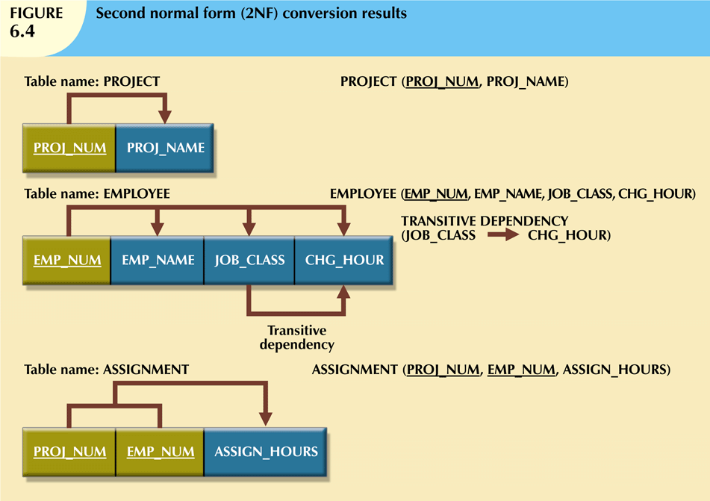
Database Systems, 9th Edition
‹#›

Slide 21
Conversion to Second Normal Form (cont’d.)
Table is in second normal form (2NF) when:
It is in 1NF and
It includes no partial dependencies:
No attribute is dependent on only portion of primary key
Database Systems, 9th Edition
‹#›

Slide 22
Conversion to Third Normal Form
Step 1: Make New Tables to Eliminate Transitive Dependencies
For every transitive dependency, write its determinant as PK for new table
Determinant: any attribute whose value determines other values within a row
Database Systems, 9th Edition
‹#›

Slide 23
Conversion to Third Normal Form (cont’d.)
Step 2: Reassign Corresponding Dependent Attributes
Identify attributes dependent on each determinant identified in Step 1
Identify dependency
Name table to reflect its contents and function
Database Systems, 9th Edition
‹#›

Slide 24
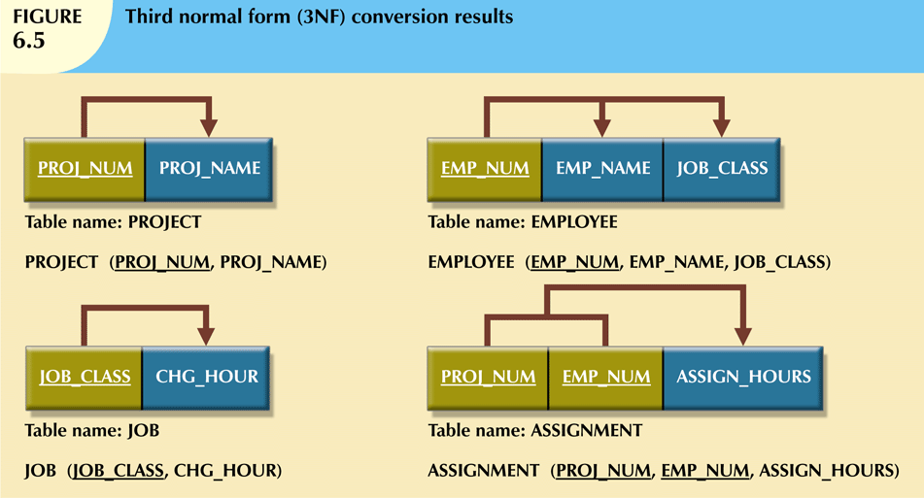
Database Systems, 9th Edition
‹#›

Slide 25
Conversion to Third Normal Form (cont’d.)
A table is in third normal form (3NF) when both of the following are true:
It is in 2NF
It contains no transitive dependencies
Database Systems, 9th Edition
‹#›

Slide 26
Improving the Design
Table structures should be cleaned up to eliminate initial partial and transitive dependencies
Normalization cannot, by itself, be relied on to make good designs
Valuable because it helps eliminate data redundancies
Database Systems, 9th Edition
‹#›

Slide 27
Improving the Design (cont’d.)
Issues to address, in order, to produce a good normalized set of tables:
Evaluate PK Assignments
Evaluate Naming Conventions
Refine Attribute Atomicity
Identify New Attributes
Identify New Relationships
Refine Primary Keys as Required for Data Granularity
Maintain Historical Accuracy
Evaluate Using Derived Attributes
Database Systems, 9th Edition
‹#›

Slide 28
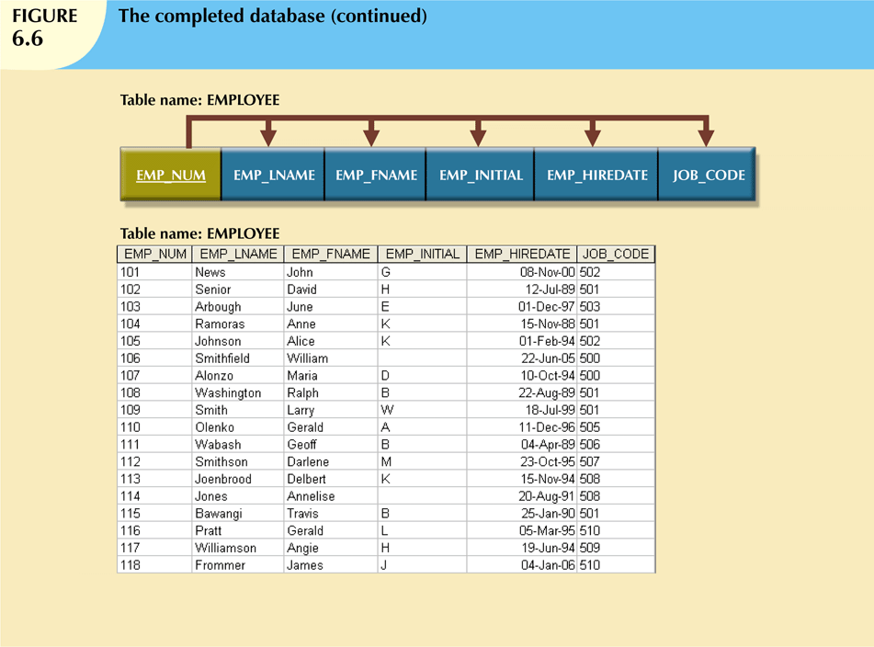
Database Systems, 9th Edition
‹#›

Slide 29
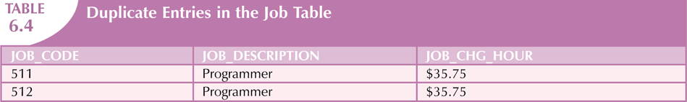
Surrogate Key Considerations
When primary key is considered to be unsuitable, designers use surrogate keys
Data entries in Table 6.4 are inappropriate because they duplicate existing records
No violation of entity or referential integrity
Database Systems, 9th Edition
‹#›

Slide 30
Higher-Level Normal Forms
Tables in 3NF perform suitably in business transactional databases
Higher-order normal forms are useful on occasion
Two special cases of 3NF:
Boyce-Codd normal form (BCNF)
Fourth normal form (4NF)
Database Systems, 9th Edition
‹#›

Slide 31
The Boyce-Codd Normal Form (BCNF)
Every determinant in table is a candidate key
Has same characteristics as primary key, but for some reason, not chosen to be primary key
When table contains only one candidate key, the 3NF and the BCNF are equivalent
BCNF can be violated only when table contains more than one candidate key
Database Systems, 9th Edition
‹#›

Slide 32
The Boyce-Codd Normal Form (BCNF) (cont’d.)
Most designers consider the BCNF as a special case of 3NF
Table is in 3NF when it is in 2NF and there are no transitive dependencies
Table can be in 3NF and fail to meet BCNF
No partial dependencies, nor does it contain transitive dependencies
A nonkey attribute is the determinant of a key attribute
Database Systems, 9th Edition
‹#›

Slide 33
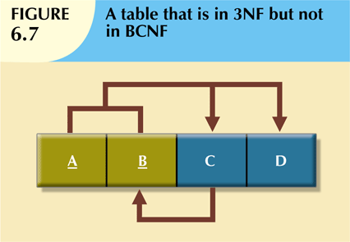
Database Systems, 9th Edition
‹#›

Slide 34
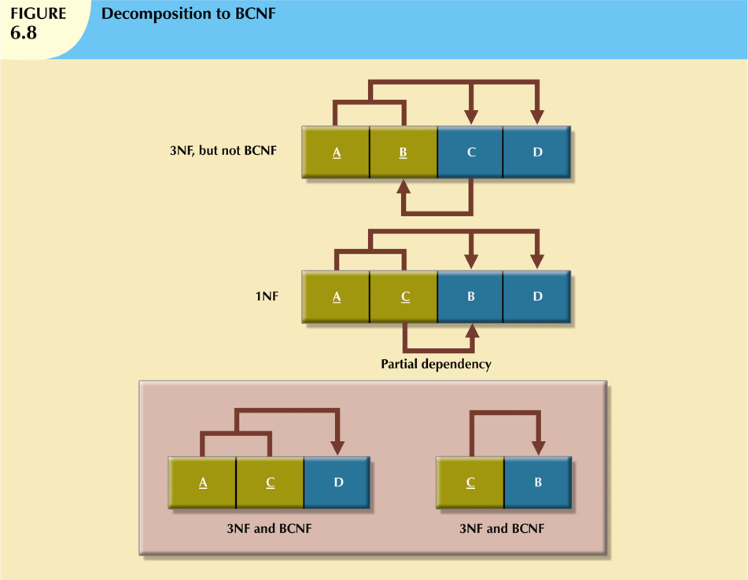
Database Systems, 9th Edition
‹#›

Slide 35
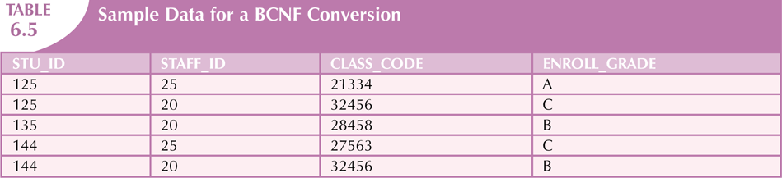
BCNF Example
Database Systems, 9th Edition
‹#›

Slide 36
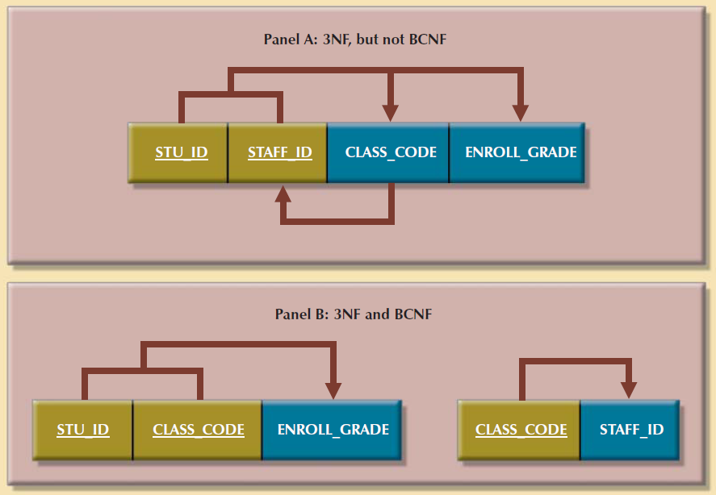
BCNF Example (Continued)
Database Systems, 9th Edition
‹#›

Slide 37
Fourth Normal Form (4NF)
Table is in fourth normal form (4NF) when both of the following are true:
It is in 3NF
No multiple sets of multivalued dependencies
4NF is largely academic if tables conform to following two rules:
All attributes dependent on primary key, independent of each other
No row contains two or more multivalued facts about an entity
Database Systems, 9th Edition
‹#›

Slide 38
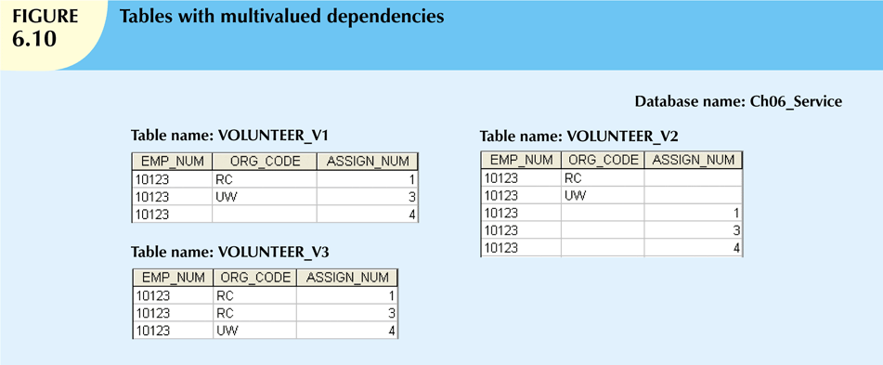
Database Systems, 9th Edition
‹#›

Slide 39
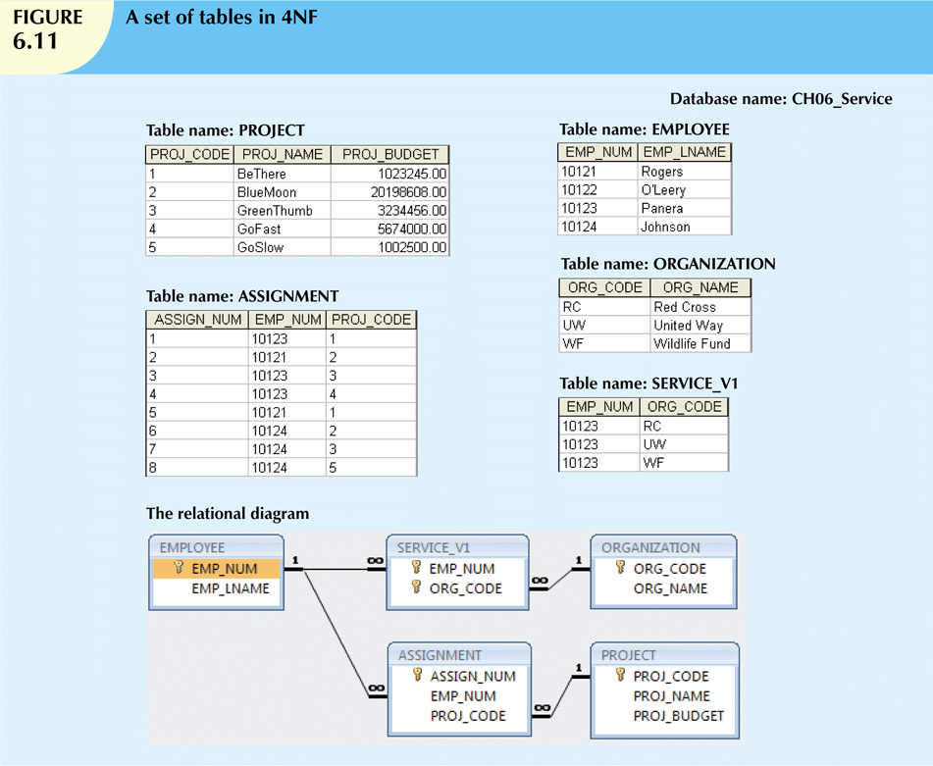
Database Systems, 9th Edition
‹#›

Slide 40
Normalization and Database Design
Normalization should be part of the design process
Make sure that proposed entities meet required normal form before table structures are created
Many real-world databases have been improperly designed or burdened with anomalies
You may be asked to redesign and modify existing databases
Database Systems, 9th Edition
‹#›

Slide 41
Normalization and Database Design (cont’d.)
ER diagram
Identify relevant entities, their attributes, and their relationships
Identify additional entities and attributes
Normalization procedures
Focus on characteristics of specific entities
Micro view of entities within ER diagram
Difficult to separate normalization process from ER modeling process
Database Systems, 9th Edition
‹#›

Slide 42
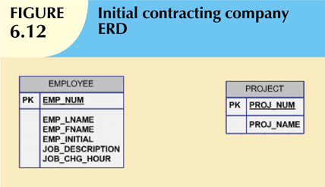
Database Systems, 9th Edition
‹#›

Slide 43
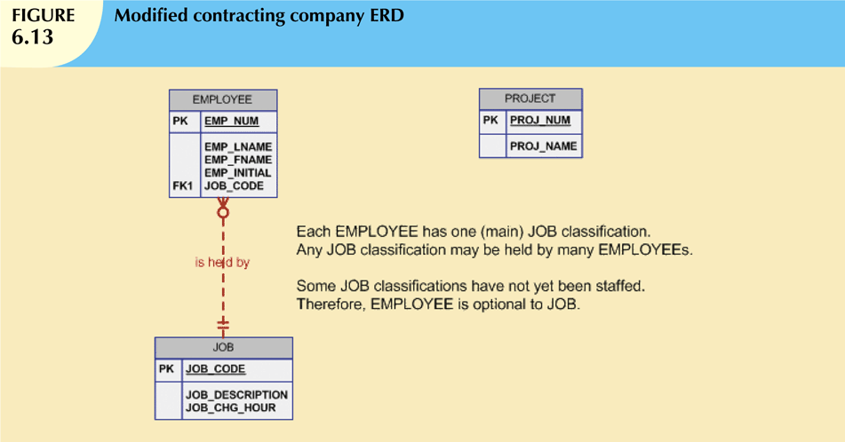
Database Systems, 9th Edition
‹#›

Slide 44
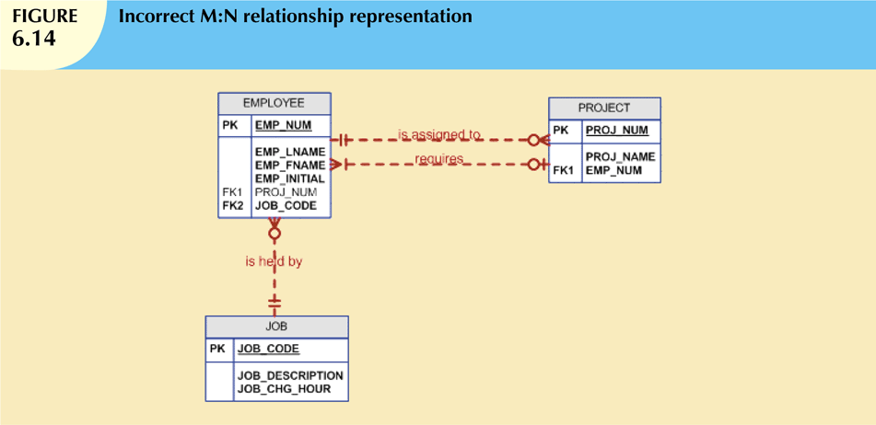
Database Systems, 9th Edition
‹#›

Slide 45
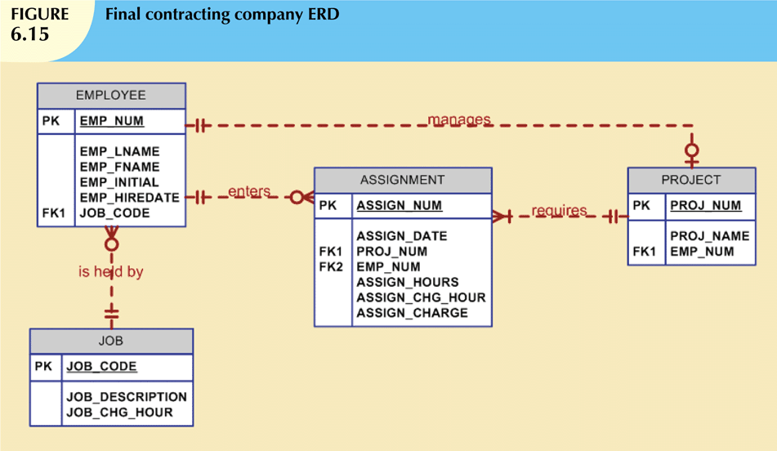
Database Systems, 9th Edition
‹#›

Slide 46
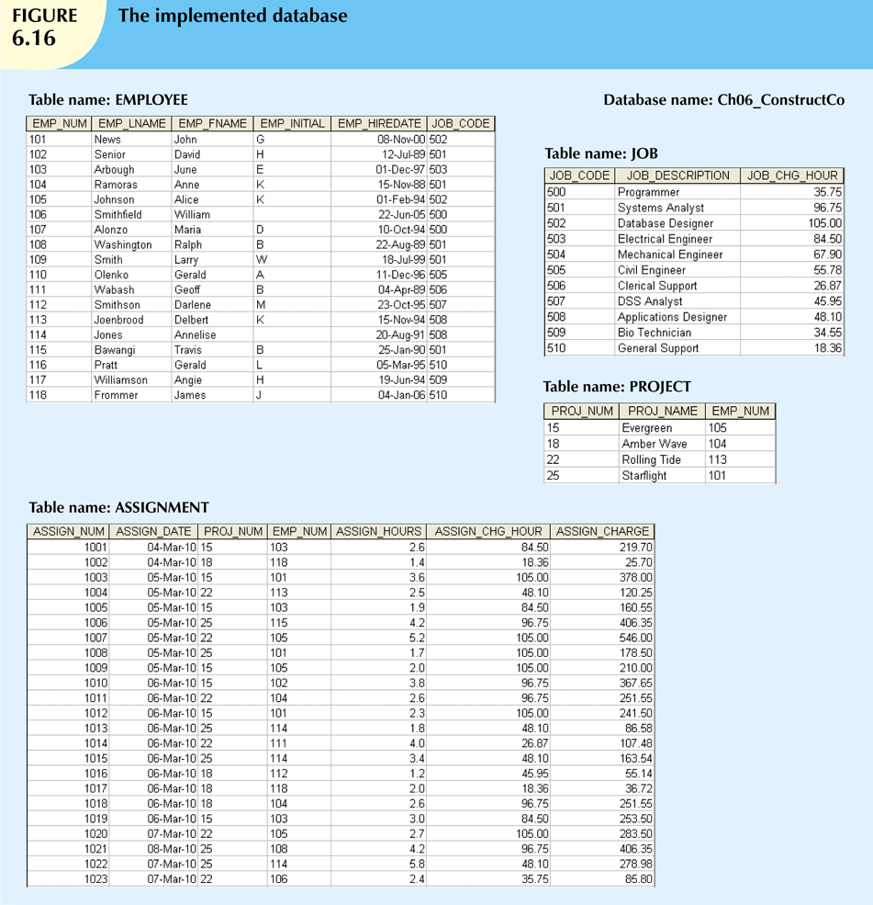
Database Systems, 9th Edition
‹#›

Slide 47
Denormalization
Creation of normalized relations is important database design goal
Processing requirements should also be a goal
If tables are decomposed to conform to normalization requirements:
Number of database tables expands
Database Systems, 9th Edition
‹#›

Slide 48
Denormalization (cont’d.)
Joining the larger number of tables reduces system speed
Conflicts are often resolved through compromises that may include denormalization
Defects of unnormalized tables:
Data updates are less efficient because tables are larger
Indexing is more cumbersome
No simple strategies for creating virtual tables known as views
Database Systems, 9th Edition
‹#›

Slide 49
Data-Modeling Checklist
Data modeling translates specific real-world environment into data model
Represents real-world data, users, processes, interactions
Data-modeling checklist helps ensure that data-modeling tasks are successfully performed
Based on concepts and tools learned in Part II
Database Systems, 8th Edition
‹#›

Slide 50
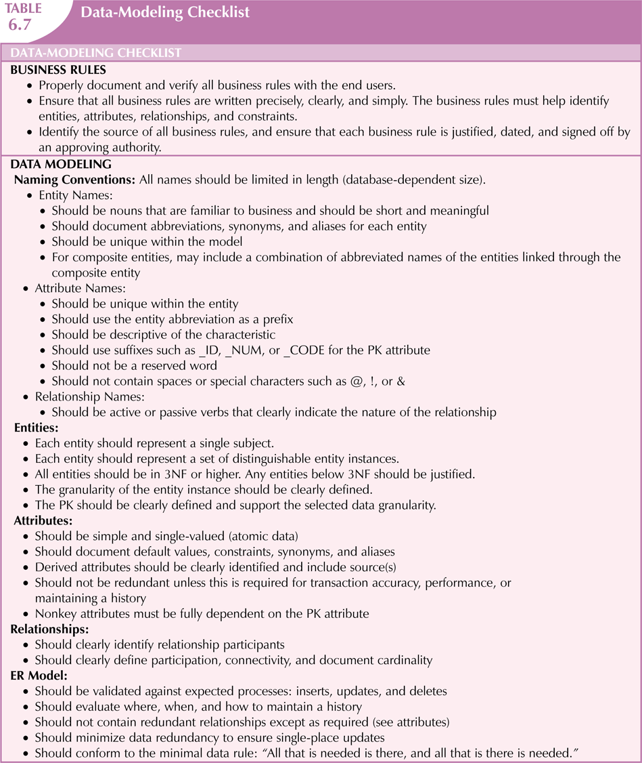
Database Systems, 8th Edition
‹#›

Slide 51
Summary
Normalization minimizes data redundancies
First three normal forms (1NF, 2NF, and 3NF) are most commonly encountered
Table is in 1NF when:
All key attributes are defined
All remaining attributes are dependent on primary key
Database Systems, 9th Edition
‹#›

Slide 52
Summary (cont’d.)
Table is in 2NF when it is in 1NF and contains no partial dependencies
Table is in 3NF when it is in 2NF and contains no transitive dependencies
Table that is not in 3NF may be split into new tables until all of the tables meet 3NF requirements
Normalization is important part—but only part—of the design process
Database Systems, 9th Edition
‹#›

Slide 53
Summary (cont’d.)
Table in 3NF may contain multivalued dependencies
Numerous null values or redundant data
Convert 3NF table to 4NF by:
Splitting table to remove multivalued dependencies
Tables are sometimes denormalized to yield less I/O, which increases processing speed
Database Systems, 9th Edition
‹#›

